Slide 1
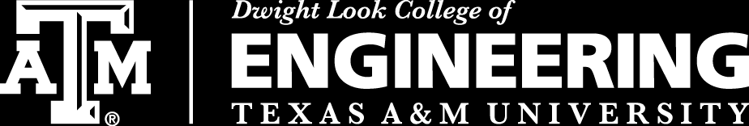
3D Inspection Rover
Sponsor:
Kevin Nowka
Team #8:
Chris Dumont
Dalton Hines
Felipe Villegas
Celeste Waters

Slide 2
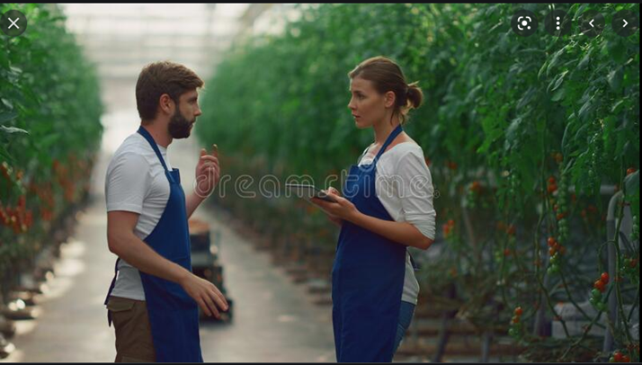
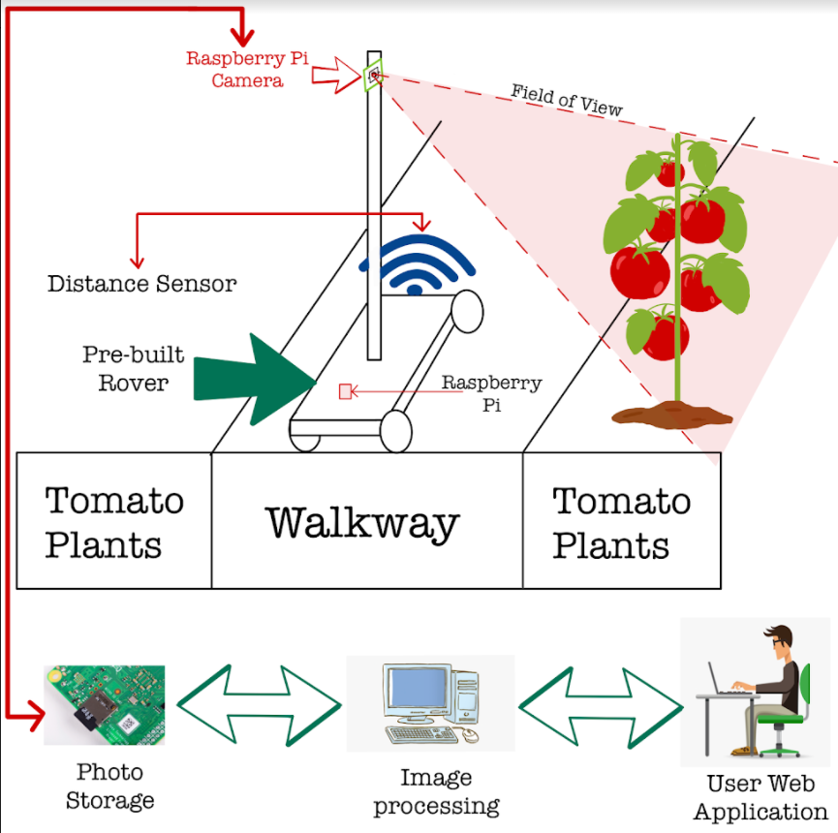
Problem Overview
Problem
Solution
A rover that will navigate the greenhouse and classify all the tomatoes autonomously
Tomato classifying is a time consuming process

Slide 3
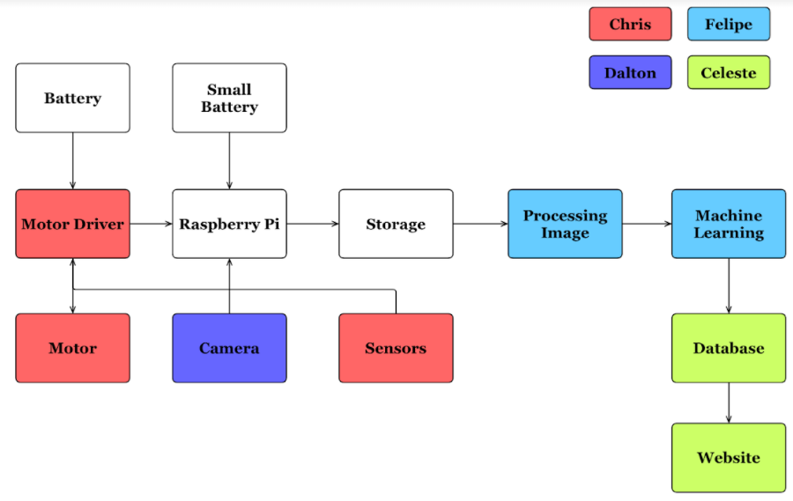
Diagram of subsystems and interface

Slide 4
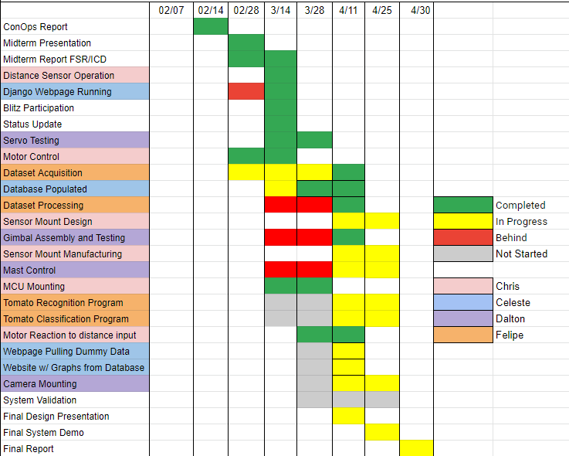
Execution Plan

Slide 5
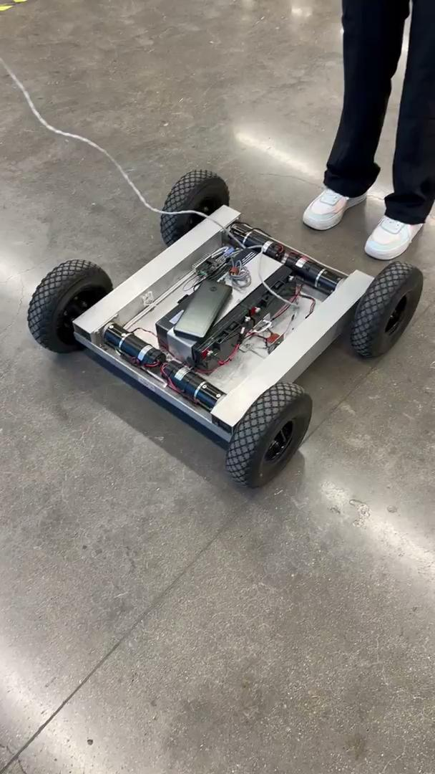
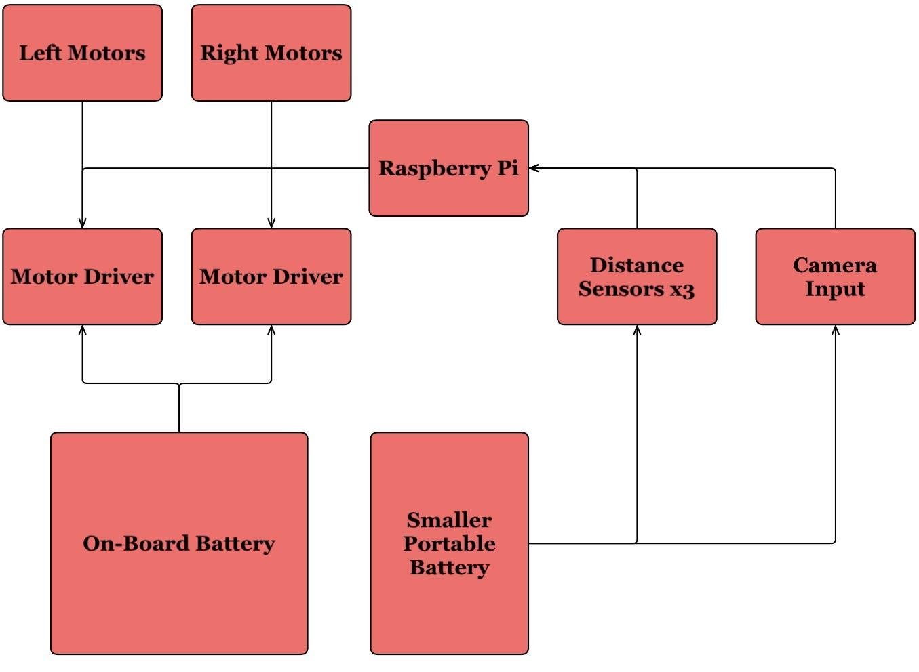
Navigation
Chris Dumont
Distance Sensors Tested
All Code needed written
Rover control achieved

Slide 6
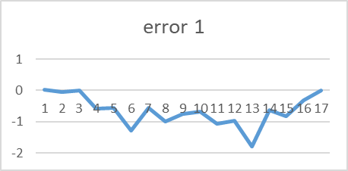
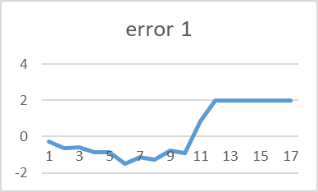
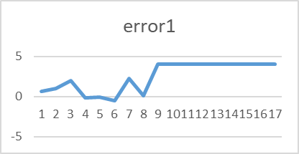
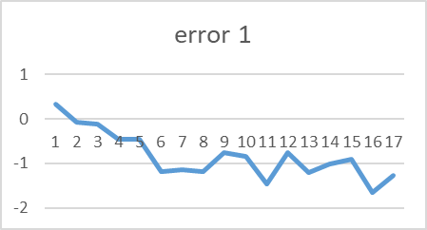
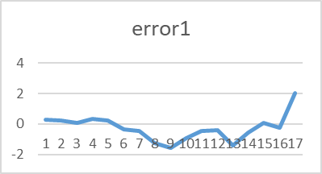
Navigation
Chris Dumont
Distance Sensor Accuracy
Vs. Cardboard
Vs. Plastic
Vs. Shoe
Vs. Concrete
Vs. Paper
Flat line indicates a lack of reading
Error is in inches
All 3 distance sensors behaved near identical

Slide 7
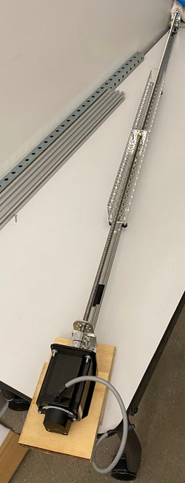
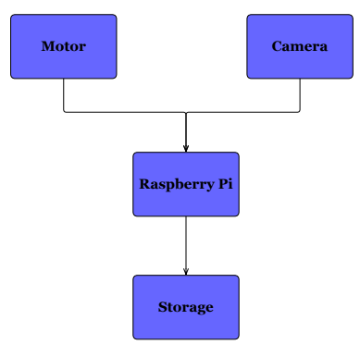
Camera Positioning & Image Capture
Dalton Hines
Gimbal Constructed
Servo Movement
Directional Implementation
Gimbal Memory

Slide 8
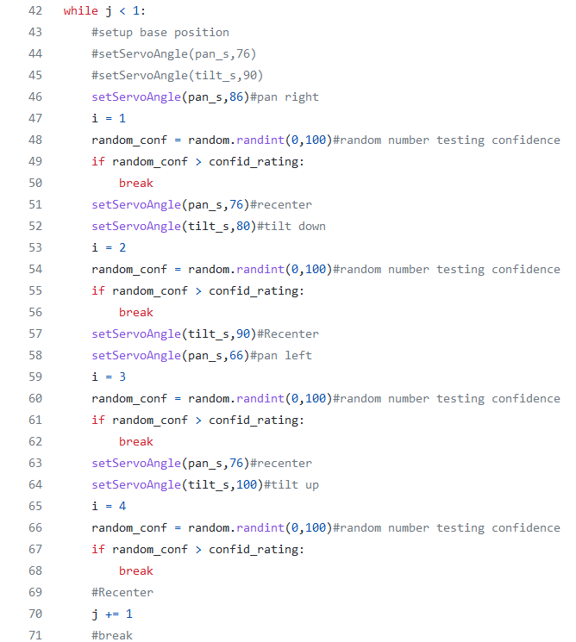
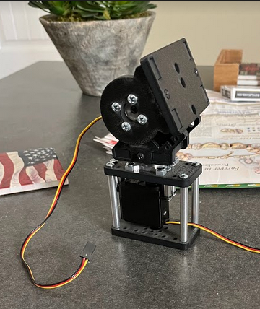
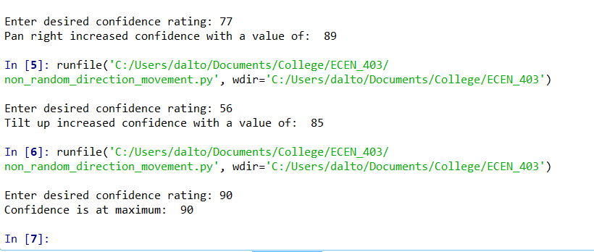

Slide 9
Tomato Recognition and Classification
Felipe Villegas
Dataset for ML Programs
Resolved data processing in model architecture
Program that classifies tomato ripeness stage
Tomato defect classification functionality (In Progress)
Program Optimization (In Progress)
YOLOv4 Implementation (In Progress)

Slide 10
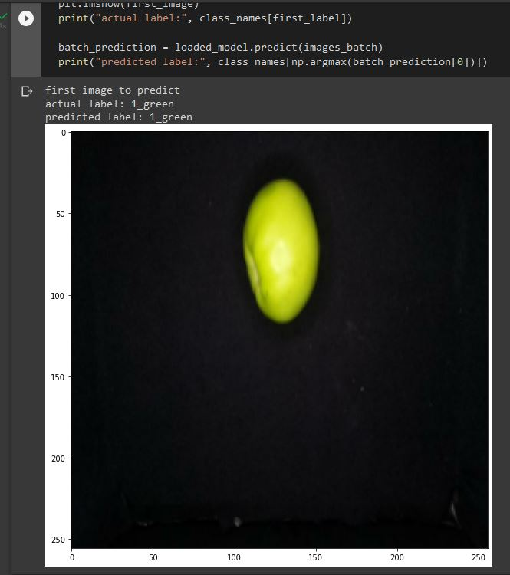
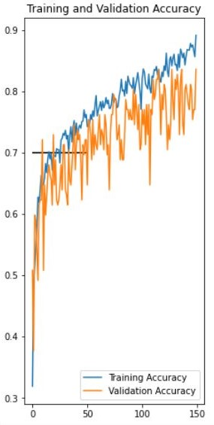
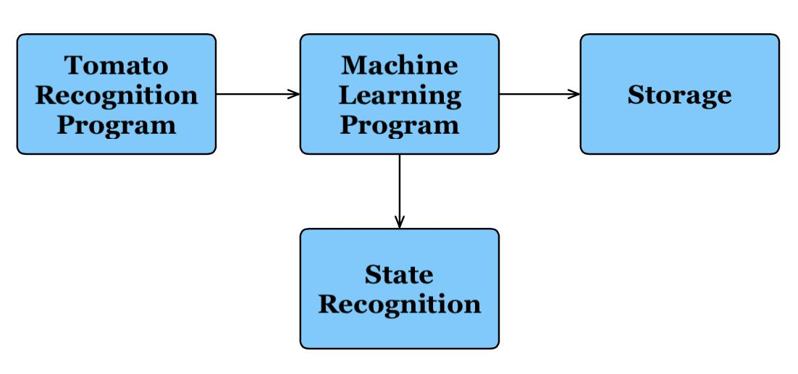

Slide 11
Database, Website, Cloud Computing Accomplishments Celeste Waters
Clickable Webpage
Error pages (404)
Authentication
Admin page (login)
Populated database (small)
Organized website
Graphed data (in progress)

Slide 12
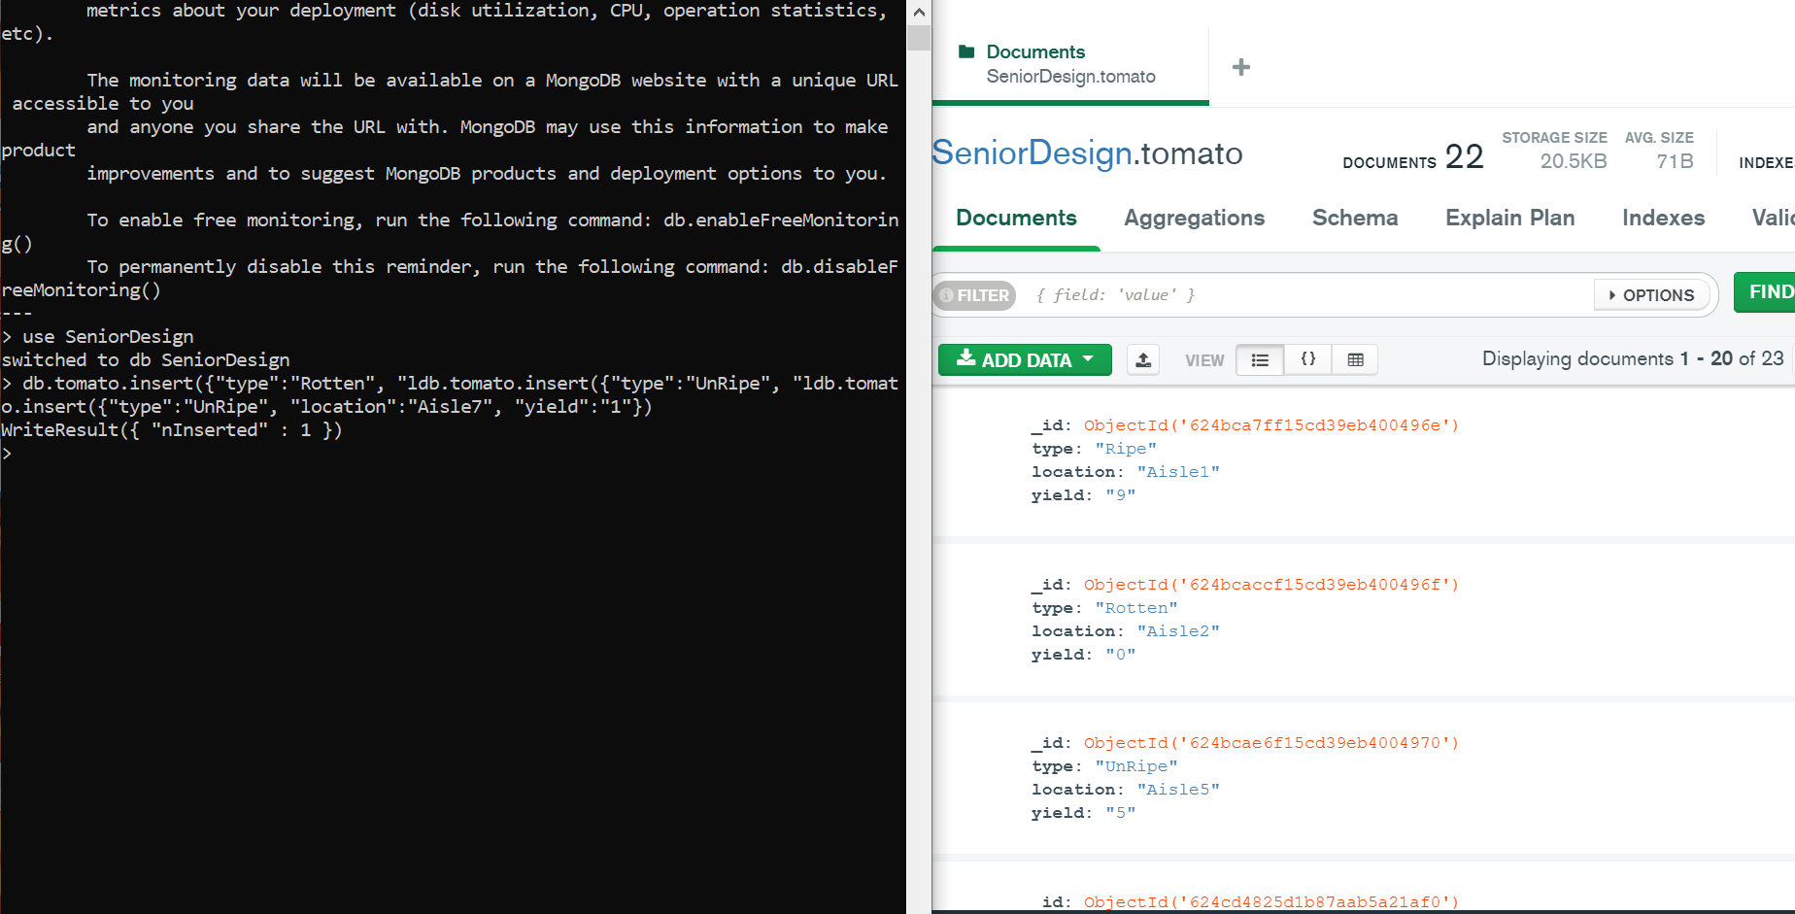
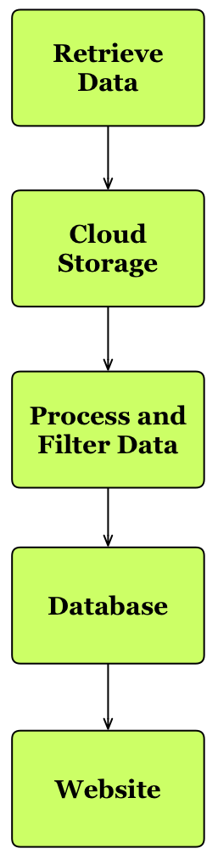
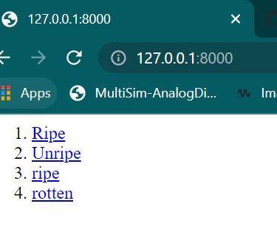
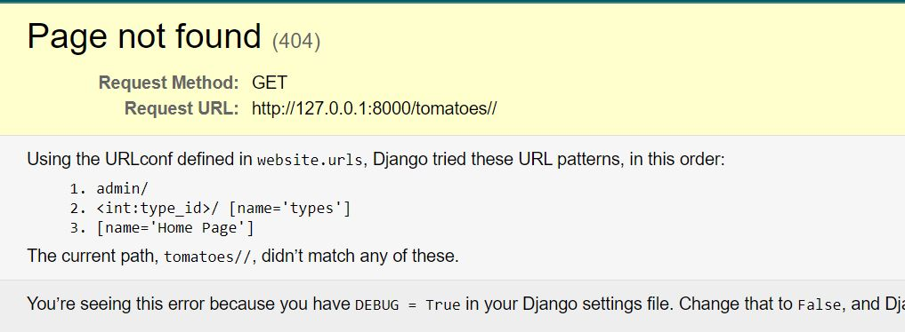

Slide 13
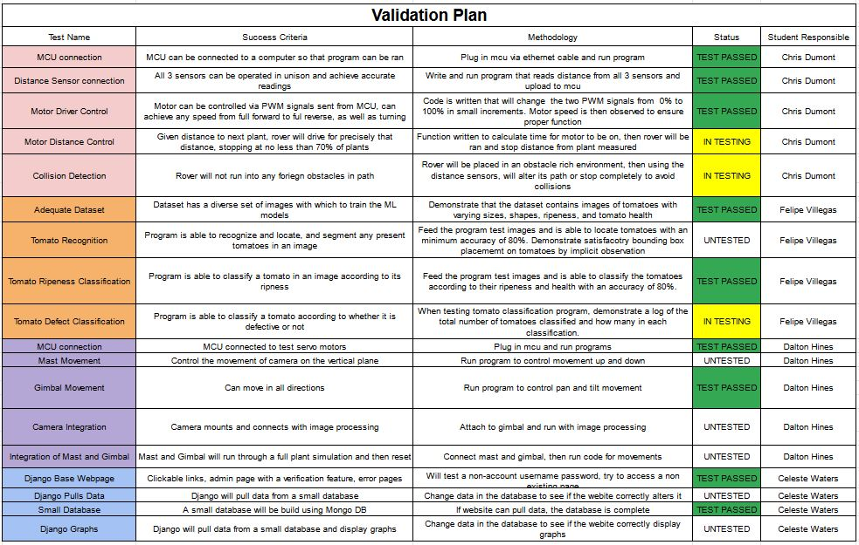
Validation Plan

Slide 14
Remaining Tasks
403
404
Mast Movement
Mast/Gimbal Integration
Mount Distance Sensors
Fine tune turning/distance control
Have rover react consistently to objects in path
Classify tomato ripeness
Locate tomato in an image
Graph Data on Website
Integration of ML with Camera Positioning
Camera Mounting
Take distance from camera for rover to travel
Determination of tomato yield by volume
Integrate all processes onto 1 MCU

